Slide 1
Principles of Data Communications
(ICT 2156)

Slide 2
ICT 2154: PRINCIPLES OF DATA COMMUNICATION [3 1 0 4]
References:
Stallings W., Data & Computer Communications (9e), Pearson Education Inc., Noida, 2017.
Frozen B., Introduction to data communication & networking (4e), Tata McGraw Hill, New Delhi-2014.
Garcia A. L., Widjaja I., Communication Networks (2e), Tata McGraw Hill, 2011.
.

Slide 3
Course Outcome
CO1 : Outline the basics of data communication
CO2 : Compute frame check sequence and error correction codes
CO3 : Explain data link layer protocol
CO4 : Compute the performance of media access protocols
.

Slide 4
ASSESSMENT PLAN:
In Semester Assessment – 50%
  Written tests : Two tests of 15 marks each ( Max. Marks: 30)
  Assignment/Quiz/Seminar: 4 assignments.
2. End Semester Examination – 50%
  Written examination of 3 hours duration. ( Max. Marks: 50)
.

Slide 5
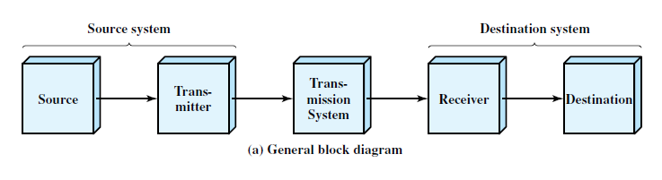
1.2 A COMMUNICATIONS MODEL
Fundamental purpose of a communications system is the exchange of data between two parties.
simple model of communications
.

Slide 6
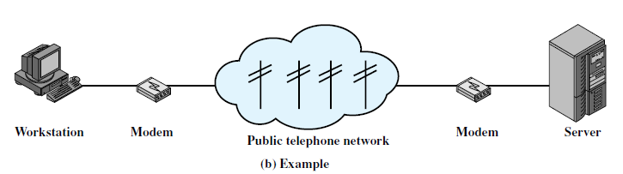
Exchange of voice signals between two telephones over the same network.
Communication between a workstation and a server over a public telephone network.
.

Slide 7
Source.
  This device generates the data to be transmitted;
  Examples : telephones and personal computers.
.

Slide 8
Transmitter:
  Data generated by a source system are not transmitted directly in the form in which they were generated.
  Transmitter transforms the information to produce electromagnetic signals that can be transmitted across some sort of transmission system.
  Modem takes a digital bit stream and transforms that bit stream into an analog signal that can be handled by the telephone network.
.

Slide 9
Transmission system:
  This can be a single transmission line or a complex network connecting source and destination.
.

Slide 10
Receiver:
  The receiver accepts the signal from the transmission system and converts it into a form that can be handled by the destination device.
  For example, a modem will accept an analog signal coming from a network or transmission line and convert it into a digital bit stream.
Destination: Takes the incoming data from the receiver.
.

Slide 11
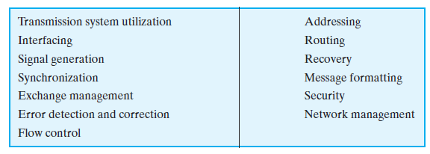
Table 1.1 Communications Tasks
items on the list could be merged;
.

Slide 12
Transmission system utilization :
Need to make efficient use of transmission facilities that are typically shared among a number of communicating devices.
Various techniques (referred to as multiplexing) are used to allocate the total capacity of a transmission medium among a number of users.
.

Slide 13
To communicate, a device must interface with the transmission system.
Once an interface is established, signal generation is required for communication.
The signal must be
  (1) capable of being propagated through the transmission system, and
  (2) interpretable as data at the receiver.
.

Slide 14
There must be some form of synchronization between transmitter and receiver.
  Receiver must be able to determine when a signal begins to arrive and when it ends.
  It must also know the duration of each signal element.
There is a variety of requirements for communication between two parties that might be collected under the term exchange management.
If data are to be exchanged in both directions over a period of time, the two parties must cooperate.
.

Slide 15
Telephone conversation
One party must dial the number of the other, causing signals to be generated that result in the ringing of the called phone.
The called party completes a connection by lifting the receiver.
For data processing devices, more will be needed than simply establishing a connection.
i.e certain conventions must be decided on.
These conventions may include :
  whether both devices may transmit simultaneously or must take turns,
  the amount of data to be sent at one time,
  the format of the data, and
  what to do if certain contingencies such as an error arise.
.

Slide 16
Two more items must be included under exchange management:
  Error detection and correction
  Flow control.
In all communications systems, there is a potential for error; transmitted signals are distorted to some extent before reaching their destination.
Error detection and correction are required in circumstances where errors cannot be tolerated.
  For example, in transferring a file from one computer to another, it is simply not acceptable for the contents of the file to be accidentally altered.
Flow control is required to assure that the source does not overwhelm the destination by sending data faster than they can be processed and absorbed.
.

Slide 17
addressing and routing.
When more than two devices share a transmission facility, a source system must indicate the identity of the intended destination.
The transmission system must assure that the destination system, and only that system, receives the data.
Further, the transmission system may itself be a network through which various paths may be taken.
A specific route through this network must be chosen.
.

Slide 18
Recovery is a concept distinct from that of error correction.
Recovery techniques are needed in situations in which an information exchange, such as a database transaction or file transfer, is interrupted due to a fault somewhere in the system.
The objective is either to be able to resume activity at the point of interruption or at least to restore the state of the systems involved to the condition prior to the beginning of the exchange.
.

Slide 19
Message formatting has to do with an agreement between two parties as to the form of the data to be exchanged or transmitted, such as the binary code for characters.
It is important to provide some measure of security in a data communications system.
The sender of data may wish to be assured that only the intended receiver actually receives the data.
The receiver of data may wish to be assured that the received data have not been altered in transit and that the data actually come from the purported sender.
.

Slide 20
Data communications facility is a complex system that cannot create or run itself.
Network management capabilities are needed to configure the system, monitor its status, react to failures and overloads, and plan intelligently for future growth.
.

Slide 21
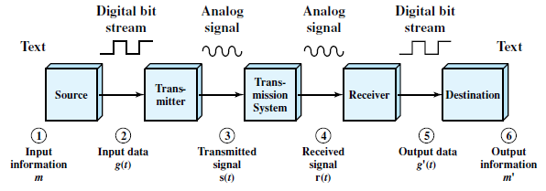
A Data Communications Model
The user of the PC wishes to send a message m (E-mail) to another user.
The input device and transmitter are components of a personal computer.
.

Slide 22
A Data Communications Model
User entered message can be viewed as a sequence of bits (g) in memory.
Input data are transferred to the transmitter as a sequence of voltage shifts [g(t)] representing bits on some communications bus or cable.
The transmitter is connected directly to the medium and converts the incoming stream [g(t)] into a signal [s(t)] suitable for transmission.
Transmitted signal s(t) in the medium is subject to a number of impairments.
Thus, the received signal r(t) may differ from s(t).
Receiver will attempt to estimate the original s(t), based on r(t) and its knowledge of the medium, producing a sequence of bits g¹(t)
.

Slide 23
A Data Communications Model
These bits are sent to the output personal computer, where they are briefly buffered in memory as a block of bits (g¹)
In many cases, the destination system will attempt to determine if an error has occurred.
If so, cooperate with the source system to eventually obtain a complete, error-free block of data.
The message (m¹) as viewed by the user will usually be an exact copy of the original message (m)
.

Slide 24
Simplex, Half Duplex, Full Duplex
There are three modes of transmission namely: simplex, half duplex, and full duplex.
Transmission mode defines the direction of flow of signal between two connected devices.
Simplex
In a simplex transmission mode, the communication between sender and receiver occurs only in one direction.
The sender can only send the data and the receiver can only receive the data.
.

Slide 25
Simplex, Half Duplex, Full Duplex
Half Duplex
The communication between sender and receiver occurs in both the directions in a half duplex transmission but, one at a time.
The sender and receiver both can send and receive the information but, only one is allowed to send at a time.
.

Slide 26
Simplex, Half Duplex, Full Duplex
Full Duplex
In a full duplex transmission mode, the communication between sender and receiver can occur simultaneously.
The sender and receiver can both transmit and receive at the same time.
For example, in a telephone, two people communicate, and both are free to speak and listen at the same time.
.

Slide 27
Analog and Digital Data
Data is an entity that conveys some meaning based on some mutually agreed up rules/conventions between a sender and a receiver.
Data can be analog or digital.
Analog data have continuous values over a time.
Digital data takes discrete value.
.

Slide 28
Analog and Digital Data
Analog data : sounds made by a human voice.
When someone speaks, an analog wave is created in the air.
Captured by a microphone.
Digital data take on discrete values.
Example : data are stored in computer memory in the form of Os and 1s.
.

Slide 29
Analog and Digital Signals
Signal : is a electric, electromagnetic or optical representation of data which can be sent over a communication media.
Signals can be either analog or digital.
Analog signal : signal intensity varies in a smooth fashion over time.
Digital signal : signal intensity maintains a constant level for some period of time and then abruptly changes to another constant level.
.

Slide 30
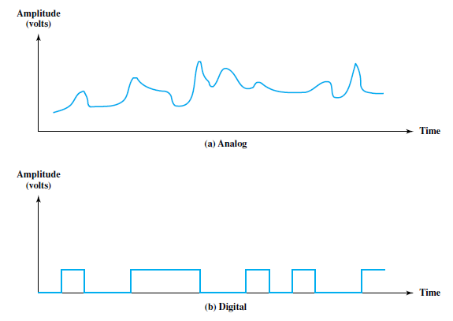
Analog and Digital Signals
.

Slide 31
Periodic and Nonperiodic Signals
Both analog and digital signals can take one of two forms: periodic or nonperiodic (aperiodic).
A periodic signal completes a pattern within a measurable time frame, called a period, and repeats that pattern over subsequent identical periods.
The completion of one full pattern is called a cycle.
A nonperiodic signal changes without exhibiting a pattern or cycle that repeats over time.
Both analog and digital signals can be periodic or nonperiodic.
.

Slide 32
PERIODIC ANALOG SIGNALS
Periodic analog signals can be classified as simple or composite.
A simple periodic analog signal, a sine wave, cannot be decomposed into simpler signals.
A composite periodic analog signal is composed of multiple sine waves.
.

Slide 33
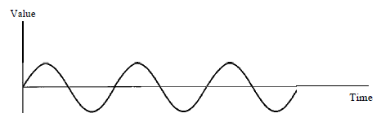
PERIODIC ANALOG SIGNALS
Sine Wave
Is the most fundamental form of a periodic analog signal.
A sine wave can be represented by three parameters: the peak amplitude, the frequency, and the phase.
Figure 3.2 A sine wave
.

Slide 34
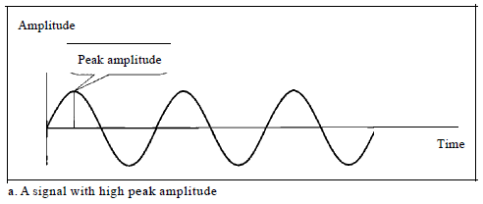
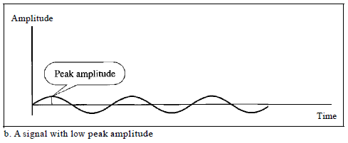
PERIODIC ANALOG SIGNALS
Sine Wave : Peak Amplitude
The peak amplitude of a signal is the absolute value of its highest intensity, proportional to the energy it carries.
Figure 3.3Two signals with the same phase and frequency, but different amplitudes
.

Slide 35

PERIODIC ANALOG SIGNALS
Sine Wave : Period and Frequency
Period refers to the amount of time ( in seconds ) a signal needs to complete 1 cycle.
Frequency refers to the number of periods in I s.
period and frequency are just one characteristic defined in two ways.
.

Slide 36
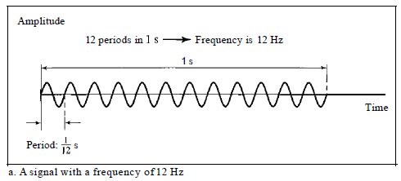
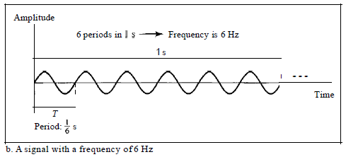
PERIODIC ANALOG SIGNALS
Sine Wave : Period and Frequency
Figure : Two signals with the same amplitude and phase, but different frequencies
.

Slide 37
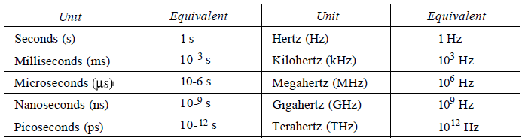
PERIODIC ANALOG SIGNALS
Sine Wave : Period and Frequency
Period is formally expressed in seconds.
Frequency is formally expressed in Hertz (Hz), which is cycle per second.
Table 3.1 Units of period and frequency
.

Slide 38

PERIODIC ANALOG SIGNALS
Sine Wave
Period and Frequency
Example 3.3
The power we use at home has a frequency of 60 Hz.
The period of this sine wave can be determined as follows:
This means that the period of the power for our lights at home is 0.0116 s, or 16.6 ms.
Our eyes are not sensitive enough to distinguish these rapid changes in amplitude.
.

Slide 39
PERIODIC ANALOG SIGNALS
Sine Wave
Period and Frequency
Frequency is the rate of change with respect to time.
Change in a short span of time means high frequency.
Change over a long span of time means low frequency.
.

Slide 40
PERIODIC ANALOG SIGNALS
Sine Wave
Phase
The term phase describes the position of the waveform relative to time O.
If we think of the wave as something that can be shifted backward or forward along the time axis, phase describes the amount of that shift.
It indicates the status of the first cycle.
.

Slide 41
PERIODIC ANALOG SIGNALS
Sine Wave
Phase
Phase is measured in degrees or radians.
A phase shift of 360° corresponds to a shift of a complete period;
a phase shift of 180° corresponds to a shift of one-half of a period;
and a phase shift of 90° corresponds to a shift of one-quarter of a period.
.

Slide 42
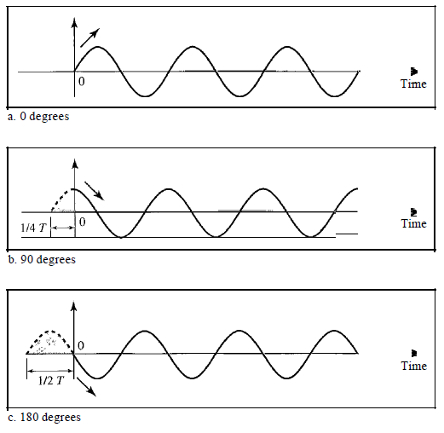
PERIODIC ANALOG SIGNALS
Sine Wave
Phase
Figure 3.5 Three sine waves with the same amplitude and frequency, but different phases
.

Slide 43
PERIODIC ANALOG SIGNALS
Sine Wave
Phase
A sine wave with a phase of 0° is not shifted.
A sine wave with a phase of 90° is shifted to the left by 1/4 cycle.
A sine wave with a phase of 180° is shifted to the left by 1/2 cycle
.

Slide 44
PERIODIC ANALOG SIGNALS
Sine Wave
Phase
Example 3.6
A sine wave is offset 1/6 cycle with respect to time O. What is its phase in degrees and radians?
.

Slide 45

PERIODIC ANALOG SIGNALS
Sine Wave
Phase
Example 3.6
A sine wave is offset 1/6 cycle with respect to time O. What is its phase in degrees and radians?
Solution
We know that 1 complete cycle is 360°. Therefore, 1/6 cycle is
1/6 * 360 = 60 = 60 * rad = rad = 1.046 rad.
.

Slide 46
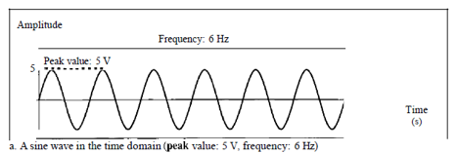
Time and Frequency Domains
A sine wave is comprehensively defined by its amplitude, frequency, and phase.
The time-domain plot shows changes in signal amplitude with respect to time (it is an amplitude-versus-time plot).
.

Slide 47
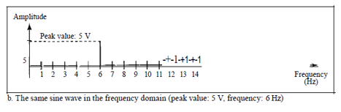
Time and Frequency Domains
.

Slide 48
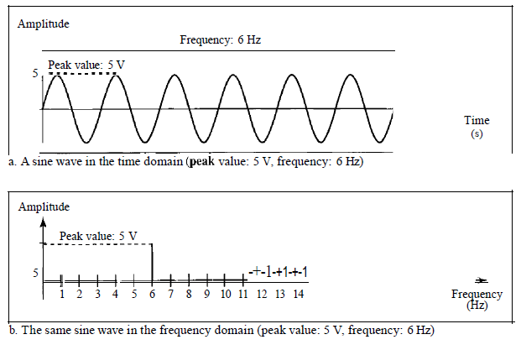
Time and Frequency Domains
Figure 3.7 The time-domain and frequency-domain plots of a sine wave
.

Slide 49
Time and Frequency Domains
Frequency domain plot conveys the information that one can find in a time domain plot.
The advantage of the frequency domain is that we can immediately see the values of the frequency and peak amplitude.
The frequency domain is more compact and useful when we are dealing with more than one sine wave.
.

Slide 50
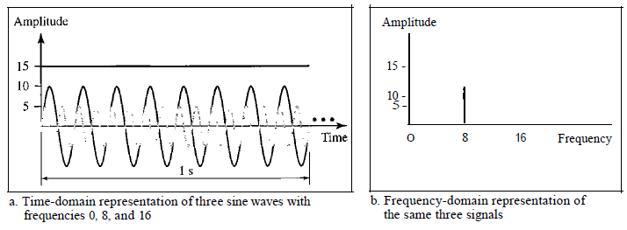
Time and Frequency Domains
Figure shows three sine waves, each with different amplitude and frequency.
All can be represented by three spikes in the frequency domain..
Figure 3.8 The time domain and frequency domain of three sine waves
.

Slide 51
Composite Signals
If we had only one single sine wave to convey a conversation over the phone, it would make no sense and carry no information.
We would just hear a buzz.
A single a frequency sine wave is not useful in data communications;
We need to send a composite signal to communicate data.
A composite signal is made of many simple sine waves.
.

Slide 52
Composite Signals
In the early 1900s, the French mathematician Jean-Baptiste Fourier showed that any composite signal is actually a combination of simple sine waves with different frequencies, amplitudes, and phases.
.

Slide 53
Composite Signals
A composite signal can be periodic or nonperiodic.
A periodic composite signal can be decomposed into a series of simple sine waves with discrete frequencies that have integer values (1, 2, 3, and so on).
A nonperiodic composite signal can be decomposed into a combination of an infinite number of simple sine waves with continuous frequencies, frequencies that have real values.
If the composite signal is periodic, the decomposition gives a series of signals with discrete frequencies;
if the composite signal is nonperiodic, the decomposition gives a combination of sine waves with continuous frequencies.
.

Slide 54
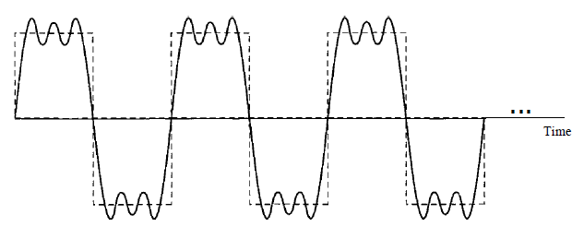
Composite Signals
Figure shows a periodic composite signal with frequency f.
This type of signal is not typical of those found in data communications.
We can consider it to be three alarm systems, each with a different frequency.
Figure 3.9 A composite periodic signal
.

Slide 55
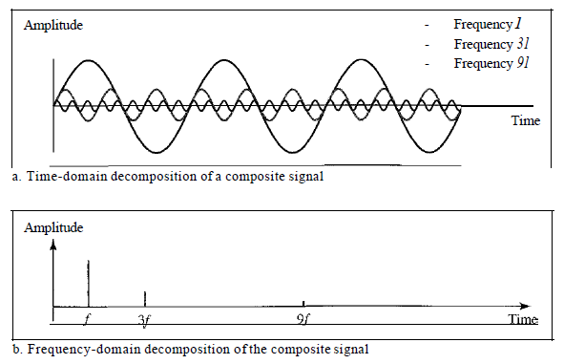
Composite Signals
It is difficult to manually decompose signal into a series of simple sine waves.
There are tools, both hardware and software, that can help us do the job.
Figure 3.10 Decomposition of a composite periodic signal in the time and frequency domains
.

Slide 56
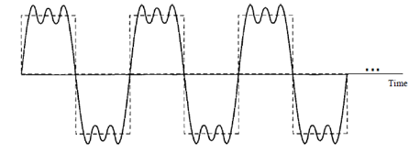
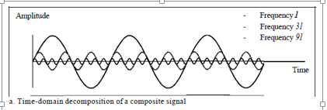
Composite Signals
The amplitude of the sine wave with frequency f is almost the same as the peak amplitude of the composite signal.
The amplitude of the sine wave with frequency 3f is one-third of that of the first, and the amplitude of the sine wave with frequency 9f is one-ninth of the first.
The frequency of the sine wave with frequency f is the same as the frequency of the composite signal; it is called the fundamental frequency, or first harmonic.
.

Slide 57
Composite Signals
The sine wave with frequency 3f has a frequency of 3 times the fundamental frequency; it is called the third harmonic.
The third sine wave with frequency 9fhas a frequency of 9 times the fundamental frequency; it is called the ninth harmonic.
.

Slide 58
Analog data :
voice
Digital data
Text or character strings
data stored in memory
Analog signal
Simple analog signal is periodic in nature
Periodic and non periodic signal
.

Slide 59
Periodic analog signal
s(t + T) = s(t) where T is t period.
.

Slide 60
Periodic analog signal characterized by 3 parameters.
Representation of sine wave
s (t ) = A sin (2πft + φ)
Where A is peak amplitude.
.

Slide 61
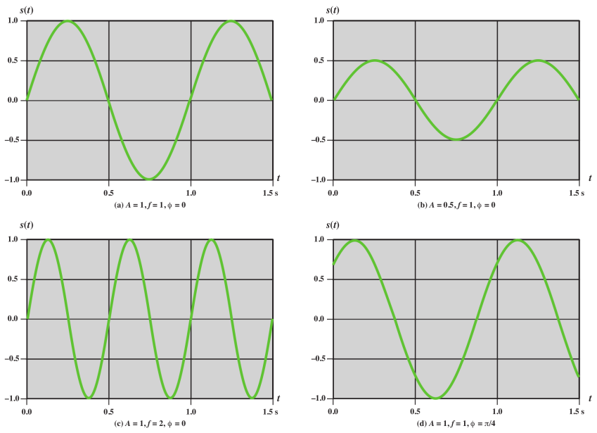
.

Slide 62
UNITS of Parameter
Amplitude : volts, milli (10⁻³) volt, KV(10³)
Frequency : Hz, KHz(10³), MHz(10⁶), GHz(10⁹), THz(10¹²)
Time : second, milli second(10⁻³), micro second(10⁻⁶), ns(10⁻⁹), ps(10⁻¹²)
Phase : degree , radian
.

Slide 63
Composite signals can be expressed as a combination of simple sine waves with different amplitude, frequency and phase.
s (t ) = A₁ sin (2πf₁t + φ₁) + A₂ sin (2πf₂t + φ₂) + A₃ sin (2πf₃t + φ₃) +……..
.

Slide 64
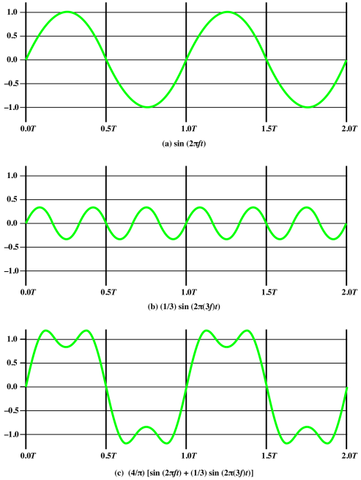
s (t ) = A₁ sin (2πf₁t + φ₁) + A₂ sin (2πf₂t + φ₂) +……..
.

Slide 65
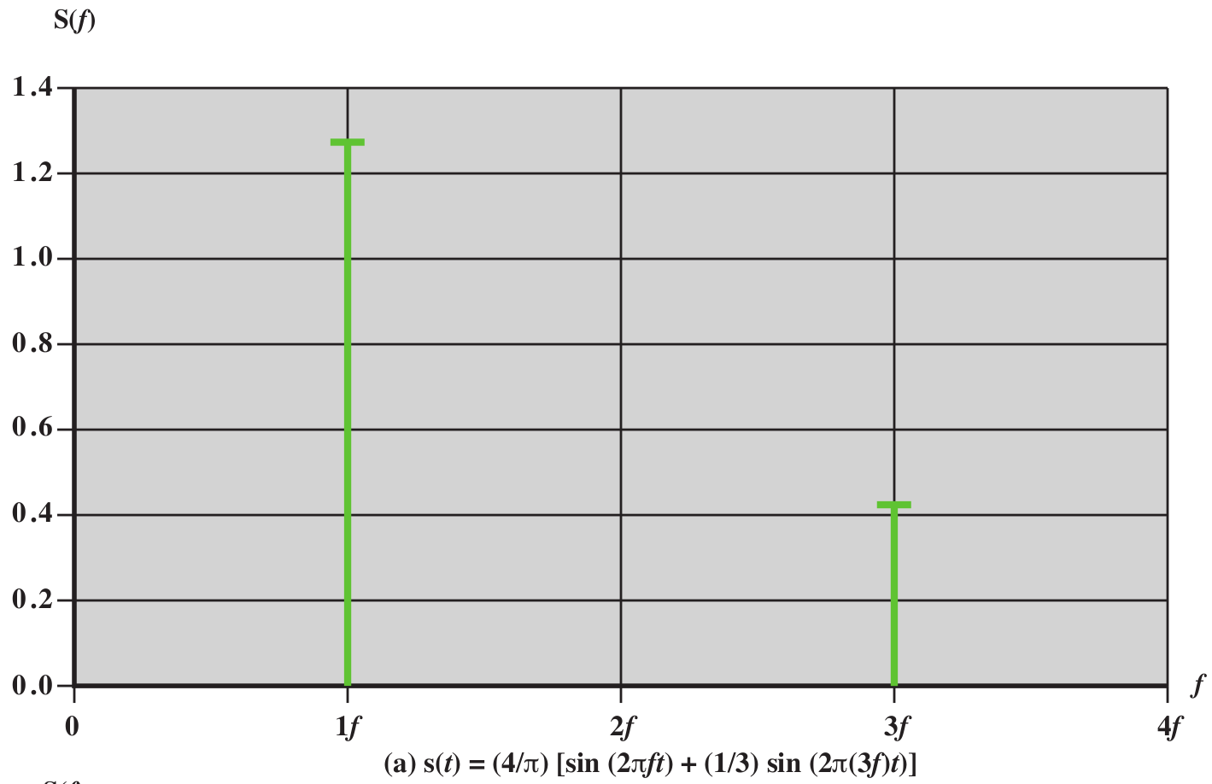
.

Slide 66
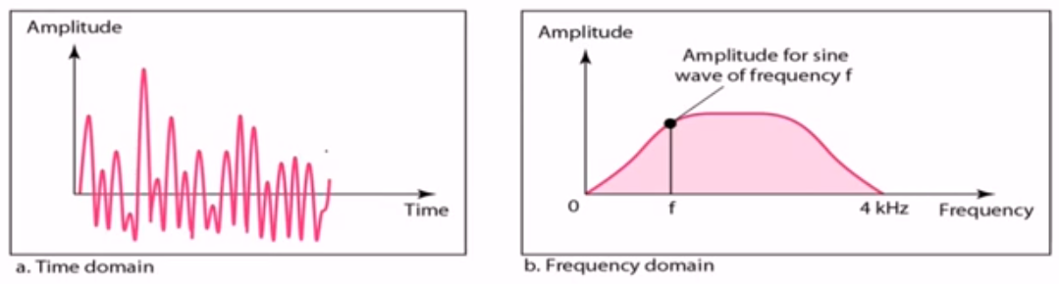
Composite Signals
Figure shows a nonperiodic composite signal.
signal created by a microphone or a telephone.
.

Slide 67
Composite Signals
In a time-domain representation of this composite signal, there are an infinite number of simple sine frequencies.
Although the number of frequencies in a human voice is infinite, the range is limited.
A normal human being can create a continuous range of frequencies between 0 and 4 kHz.
.

Slide 68
Frequency Domain Concepts
The spectrum of a signal is the range of frequencies that it contains.
The absolute bandwidth of a signal is the width of the spectrum.
Many signals have an infinite bandwidth.
However, most of the energy in the signal is contained in a relatively narrow band of frequencies.
This band is referred to as the effective bandwidth, or just bandwidth.
.

Slide 69
Bandwidth
The bandwidth of a composite signal is the difference between the highest and the lowest frequencies contained in that signal.
For example, if a composite signal contains frequencies between 1000 and 5000, its bandwidth is 5000 - 1000, or 4000.
.

Slide 70
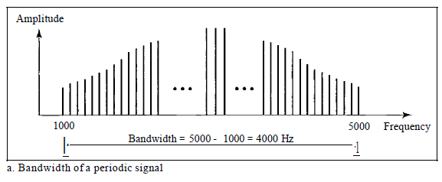
Bandwidth
The figure depicts periodic composite signals.
The bandwidth of the periodic signal contains all integer frequencies between 1000 and 5000 (1000, 100 I, 1002, ...).
Figure 3.12 The bandwidth of periodic composite signals
.

Slide 71
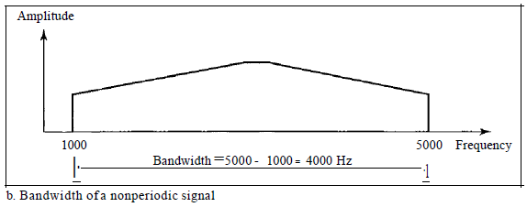
Bandwidth
The figure depicts nonperiodic composite signals.
The bandwidth of the nonperiodic signals has the same range, but the frequencies are continuous.
Figure 3.12 The bandwidth of nonperiodic composite signals
.

Slide 72
Bandwidth
If a periodic signal is decomposed into five sine waves with frequencies of 100, 300, 500, 700, and 900 Hz, what is its bandwidth?
Draw the spectrum, assuming all components have a maximum amplitude of 10 V.
.

Slide 73
Bandwidth
If a periodic signal is decomposed into five sine waves with frequencies of 100, 300, 500, 700, and 900 Hz, what is its bandwidth?
Draw the spectrum, assuming all components have a maximum amplitude of 10 V.
Solution
Let f_{h} be the highest frequency, f_{l} the lowest frequency, and B the bandwidth.
Then B =f_{h} - i_{t} = 900 - 100 =800 Hz
The spectrum has only five spikes, at 100, 300, 500, 700, and 900 Hz.
.

Slide 74
Bandwidth
Example 3.12
A nonperiodic composite signal has a bandwidth of 200 kHz, with a middle frequency of140 kHz and peak amplitude of 20 V.
The two extreme frequencies have an amplitude of 0.
Draw the frequency domain of the signal..
.

Slide 75
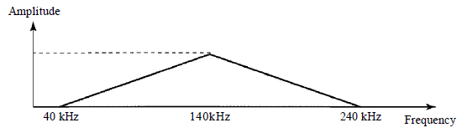
Bandwidth
Example 3.12
A nonperiodic composite signal has a bandwidth of 200 kHz, with a middle frequency of140 kHz and peak amplitude of 20 V.
The two extreme frequencies have an amplitude of 0.
Draw the frequency domain of the signal..
Solution
The lowest frequency must be at 40 kHz and the highest at 240 kHz.
Figure 3.15 shows the frequency domain and the bandwidth.
.

Slide 76
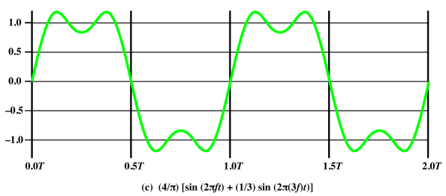
.

Slide 77
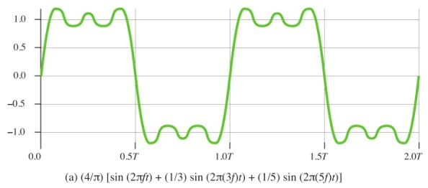
.

Slide 78
.

Slide 79
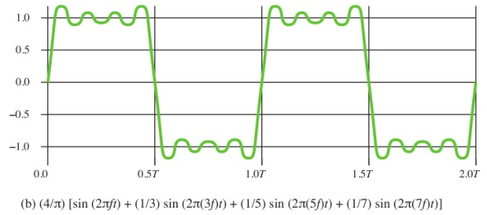
.

Slide 80
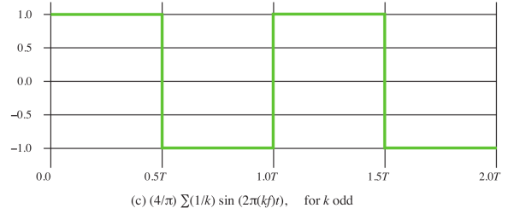
.

Slide 81

The frequency components of the square wave with amplitudes A and can be expressed as follows:
.

Slide 82
Digital signal
Based on Fourier analysis, a digital signal is a composite analog signal.
A digital signal can be considered as a signal with an infinite number of frequencies.
.

Slide 83
DIGITAL SIGNALS
Digital Signal as a Composite Analog Signal
Fourier analysis can be used to decompose a digital signal.
If the digital signal is periodic, which is rare in data communications, the decomposed signal has a frequency domain representation with an infinite bandwidth and discrete frequencies.
If the digital signal is nonperiodic, the decomposed signal still has an infinite bandwidth, but the frequencies are continuous.
.

Slide 84

DIGITAL SIGNALS
.

Slide 85
DIGITAL SIGNALS
Both bandwidths are infinite, but the periodic signal has discrete frequencies while the nonperiodic signal has continuous frequencies.
.

Slide 86
Digital signal
Most digital signals are nonperiodic, and thus period and frequency are not appropriate characteristics.
Bit interval
Time required to send a single bit.
.

Slide 87
Digital signal
Bit Rate
Term bit rate (instead of frequency)-is used to describe digital signals.
Number of bits sent in 1 second, expressed in bits per second (bps).
Number of bit intervals per second.
.

Slide 88
Digital signal
A digital signal can have more than two levels.
In this case, we can send more than 1 bit for each level.
.

Slide 89

Digital signal
.

Slide 90
DIGITAL SIGNALS
We send 1 bit per level in part a of the figure and 2 bits per level in part b of the figure.
In general, if a signal has L levels, each level needs log ₂L bits.
.

Slide 91
DIGITAL SIGNALS
We send 1 bit per level in part a of the figure and 2 bits per level in part b of the figure.
In general, if a signal has L levels, each level needs log ₂L bits.
A digital signal has eight levels. How many bits are needed per level?
.

Slide 92
DIGITAL SIGNALS
A digital signal has eight levels. How many bits are needed per level?
Number of bits per level =log₂ 8 =3
Each signal level is represented by 3 bits.
.

Slide 93
Digital signal Transmission
There are two different approaches for the transmission of digital signals:
Baseband transmission
Broadband transmission (using modulation)
.

Slide 94
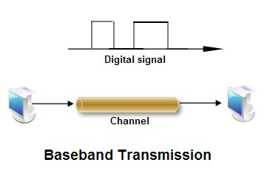
Digital signal Transmission
Baseband transmission means sending a digital signal over a channel without changing the digital signal to an analog signal.
.

Slide 95
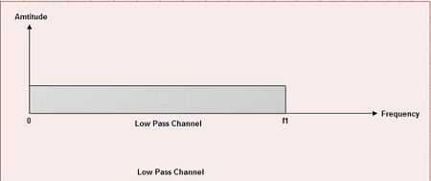
Digital signal Transmission
Baseband transmission requires low pass channel for transmission.
A low pass channel is a channel whose bandwidth starts from zero.
.

Slide 96
DIGITAL SIGNALS
Transmission of Digital Signals.
Baseband Transmission
This is the case if we have a dedicated medium with a bandwidth constituting only one channel.
Examples
The entire bandwidth of a cable connecting two computers is one single channel.
We may connect several computers to a bus, but not allow more than two stations to communicate at a time.
.

Slide 97
DIGITAL SIGNALS
Transmission of Digital Signals.
Baseband Transmission
We need to remember that a low-pass channel with infinite bandwidth is ideal, but we cannot have such a channel in real life. However, we can get close.
If we want to preserve the exact form of a digital signal, we need to send the entire spectrum, the continuous range of frequencies between zero and infinity.
This is possible if we have a dedicated medium with an infinite bandwidth that preserves the exact amplitude of each component of the composite signal.
Fortunately, the amplitudes of the frequencies at the border of the bandwidth are so small that they can be ignored.
This means that if we have a medium, such as a coaxial cable or fiber optic, with a very wide bandwidth, two stations can communicate by using digital signals with very good accuracy.
.

Slide 98

DIGITAL SIGNALS
Transmission of Digital Signals.
Baseband Transmission
.

Slide 99
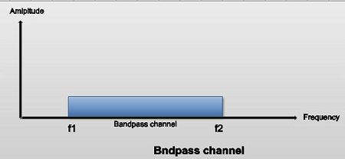
Digital signal Transmission
Broadband Transmission
Broadband transmission means sending a digital signal over a channel after changing the digital signal to analog signal i.e. it requires modulation.
Broadband transmission can use bandpass channel.
A bandpass channel is a channel whose bandwidth does not start from zero.
A bandpass channel is more available than a lowpass channel.
.

Slide 100
Broadband Transmission (Using modulation)
If the available channel is a bandpass channel~we cannot send the digital signal directly to the channel;
we need to convert the digital signal to an analog signal before transmission.
.

Slide 101
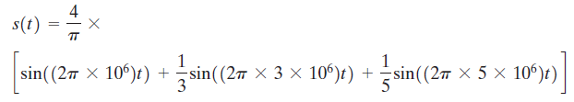
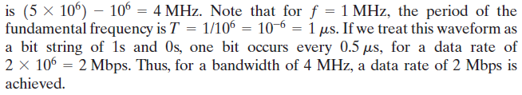
Relationship between Data Rate and Bandwidth
What data rate can be achieved? We look at three cases.
Case I. Let us approximate our square wave with the waveform of Figure 3.7a.
Although this waveform is a “distorted” square wave, it is sufficiently close to the square wave that a receiver should be able to discriminate between a binary 0 and a binary 1.
the signal
.

Slide 102
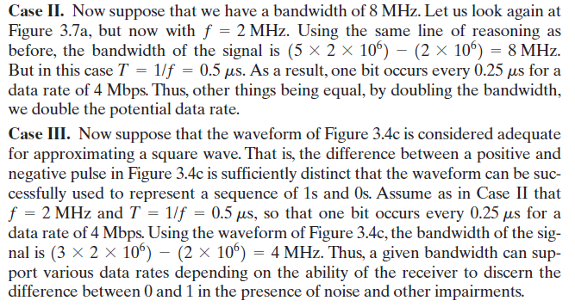
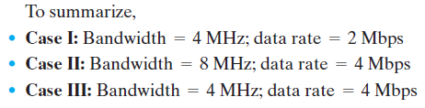
Relationship between Data Rate and Bandwidth
.

Slide 103
.

Slide 104
TRANSMISSION IMPAIRMENTS
The signal that is received may differ from the signal that is transmitted due to various transmission impairments.
For analog signals, these impairments can degrade the signal quality.
For digital signals, bit errors may be introduced.
ie 1 is transformed into 0 or vice versa.
The most significant impairments are
  Attenuation and attenuation distortion
  Delay distortion
  Noise
.

Slide 105

Attenuation
Attenuation can be considered as a loss of energy as the signal passes through the medium.
Attenuation leads to loss of energy expressed in decibel.
.

Slide 106
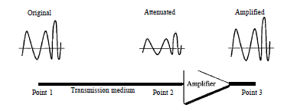
Attenuation
To compensate for this loss, amplifiers are used to amplify the signal.
.

Slide 107
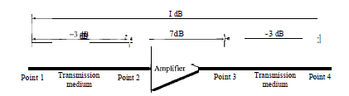

Attenuation
Decibel numbers can be added (or subtracted) when we are measuring several points (cascading) instead of just two.
In Figure a signal travels from point 1 to point 4.
We can find the resultant decibel value for the signal just by adding the decibel measurements between each set of points.
In this decibel value can be calculated as
.

Slide 108
If the attenuation of the medium varies with frequency this leads to attenuation distortion.
This problem is particularly noticeable for analog signals.
To eliminate the attenuation equalization is employed.
.

Slide 109
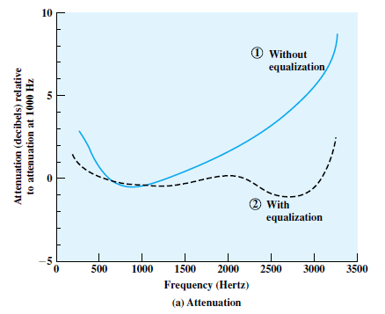
Figure shows attenuation as a function of frequency for a typical leased line.
In figure, attenuation is measured relative to the attenuation at 1000 Hz.
.

Slide 110
Delay Distortion
Delay distortion occurs because the velocity of propagation of a signal through a guided medium varies with frequency.
Happen in composite signal made of different frequencies.
Thus various frequency components of a signal will arrive at the receiver at different times, resulting in phase shifts between the different frequencies.
This effect is referred to as delay distortion because the received signal is distorted due to varying delays experienced at its constituent frequencies.
Delay distortion is particularly critical for digital data.
.

Slide 111
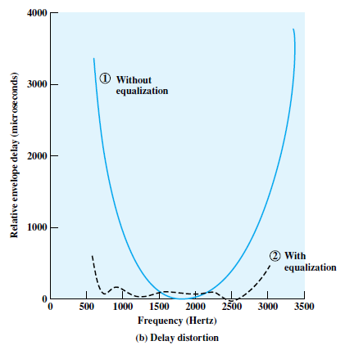
Delay Distortion
Equalizing techniques is used for delay distortion.
Using a leased telephone line as an example, Figure shows the effect of equalization on delay as a function of frequency.
.

Slide 112
Noise
For any data transmission event, the received signal will consist of the transmitted signal, modified by the various distortions imposed by the transmission system, plus additional unwanted signals that are inserted somewhere between transmission and reception.
The undesired signals are referred to as noise.
Noise is the major limiting factor in communications system performance.
Noise may be divided into four categories:
  Thermal noise
  Intermodulation noise
  Crosstalk
  Impulse noise
.

Slide 113

Thermal noise ( white noice )
Thermal noise is due to thermal agitation of electrons.
It is present in all electronic devices and transmission media and is a function of temperature.
Thermal noise cannot be eliminated and therefore places an upper bound on communications system performance.
Thermal noise (in watts ) present in a bandwidth of B Hertz can be expressed as
Where K = boltzmanns constant = 1.38 x10⁻²³
T = temperature in kelvin
N = Noise in watt
.

Slide 114
intermodulation noise.
Intermodulation noise is generated when a signal of different frequencies share the same transmission media.
The effect of intermodulation produce signals with different frequencies which are sum or difference or multiples of those frequencies.
For example, the mixing of signals at frequencies f₁ and f₂ might produce energy at the frequency f₁ + f₂ .
This derived signal could interfere with an intended signal at the frequency f₁ + f_{2.}
Intermodulation of signal takes place when there is a component malfunction such as nonlinearity in transmitter, receiver.
Another cause is excessive signal strength.
.

Slide 115
Crosstalk
While using the telephone, able to hear another conversation;
it is an unwanted coupling between signal paths.
Can occur by electrical coupling between nearby twisted pairs or, coaxial cable lines carrying multiple signals.
Crosstalk can also occur when microwave antennas pick up unwanted signals;
.

Slide 116
Impulse noise
Impulse noise consisting of irregular pulses or noise spikes of short duration and of relatively high amplitude.
Generated because of external electromagnetic disturbances, such as lightning, or faults and flaws in the communications system.
Impulse noise is generally only a minor annoyance for analog data.
Impulse noise is the primary source of error in digital data communication
.

Slide 117
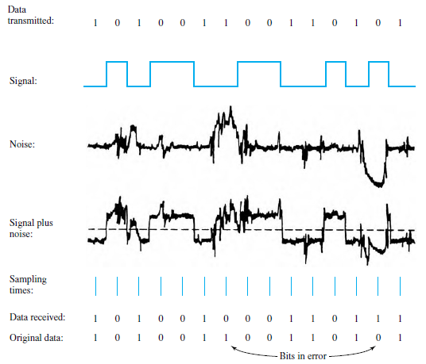
Impulse noise
Figure is an example of the effect of noise on a digital signal.
Digital data can be recovered from the signal by sampling the received waveform once per bit time.
The noise is occasionally sufficient to change a 1 to a 0 or a 0 to a 1.
Figure 3.16 Effect of Noise on a Digital Signal
.

Slide 118
CHANNEL CAPACITY
The maximum rate at which data can be transmitted over a given communication channel, under given conditions.
Data rate: The rate, in bits per second (bps), at which data can be communicated
Error rate: The rate at which errors occur, where an error is the reception of a 1 when a 0 was transmitted and vice versa.
.

Slide 119

Nyquist Bandwidth
Defines the theoretical maximum bit rate for the noiseless channel or ideal channel.
Given by
B is the bandwidth of the channel
M is the number of signal levels used to represent the data.
.

Slide 120
Nyquist Bandwidth
For a given bandwidth, the data rate can be increased by increasing the number of different signal elements.
This places an increased burden on the receiver.
Instead of distinguishing one of two possible signal elements during each signal time, it must distinguish one of M possible signal elements.
.

Slide 121
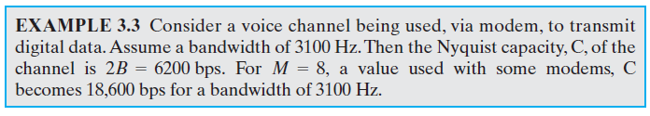
Nyquist Bandwidth
.

Slide 122

Shannon Capacity Formula
We can not have a noiseless channel.
The maximum data rate for any noisy channel is
B is the bandwidth of the channel in Hertz
SNR is the signal to noise ratio.
C is the channel capacity in bits per second.
.

Slide 123

Shannon Capacity Formula
Signal to noise ratio is represented in decibels:
A high SNR will mean a high-quality signal.
.

Slide 124
Shannon Capacity Formula
Shannon formula represents the theoretical maximum that can be achieved.
In practice, however, only much lower rates are achieved.
One reason for this is that the formula assumes white noise (thermal noise). Impulse noise is not accounted for, nor are attenuation distortion or delay distortion.
.

Slide 125
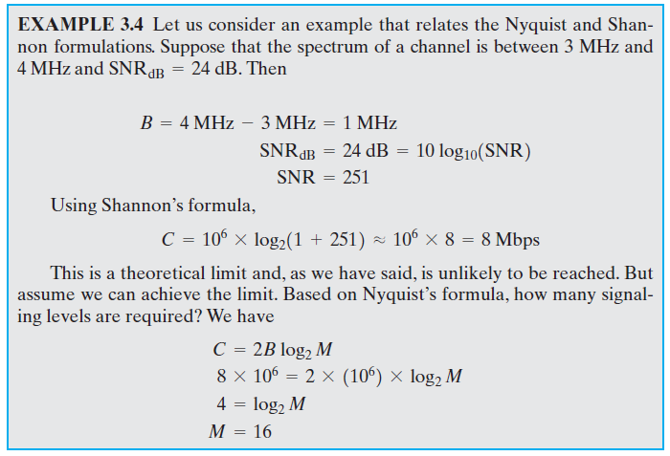
Shannon Capacity Formula
.

